Slide 1
BMI 6203 Group Project
Styx Genetics
Group Members: Angela Lam, John Arnn, Kent Storm, Miguel Cuevas

Slide 2
Business Description for Styx Genetics
Precision Medicine for Life
Utilization of new techniques and analytical technologies
Provides risk scores and predisposition analyses for most known human diseases
Detailed personalized information on wellness factors like optimal diet, best sleep/recovery practices, and potential injury risk
Specialized reports for medical professionals and parents
Includes lifetime updates

Slide 3
Data Requirements
Every patient is tracked with by a unique patient ID (PID), patient name, patient parents, date of birth, address, phone number, and provider
A payment method must also be included which includes out of pocket or through insurance.
If through insurance, policy number, the company’s name with its phone number and address must be provided.

Slide 4
Data Requirements
Patients will be able to provide different sample types for their convenience either blood, saliva, or buccal swab.
These will be tracked via Sample ID (SID).
Multiple samples may be required due to possible lab complications.
Samples will be collected with kits that have barcodes included in the packaging.

Slide 5
Data Requirements
Samples then enter a LIMS system that tracks processing.
Step 01: Extraction of DNA from the sample. This will produce one or more tubes of differing concentration.
Step 02: The DNA must be prepared for sequencing producing a new container that holds DNA that is ready to be sequenced.

Slide 6
Data Requirements
Step 03: Sequencing data will be produced that is contained in a unique file.
Each step must contain:
The ID and type of instrument the sample was ran on.
The ID for the technician who ran the sample.
Unique ID, Name, and Job Title
Start and End Dates

Slide 7
Data Requirements
Two sperate reports must be saved and tracked

Slide 8
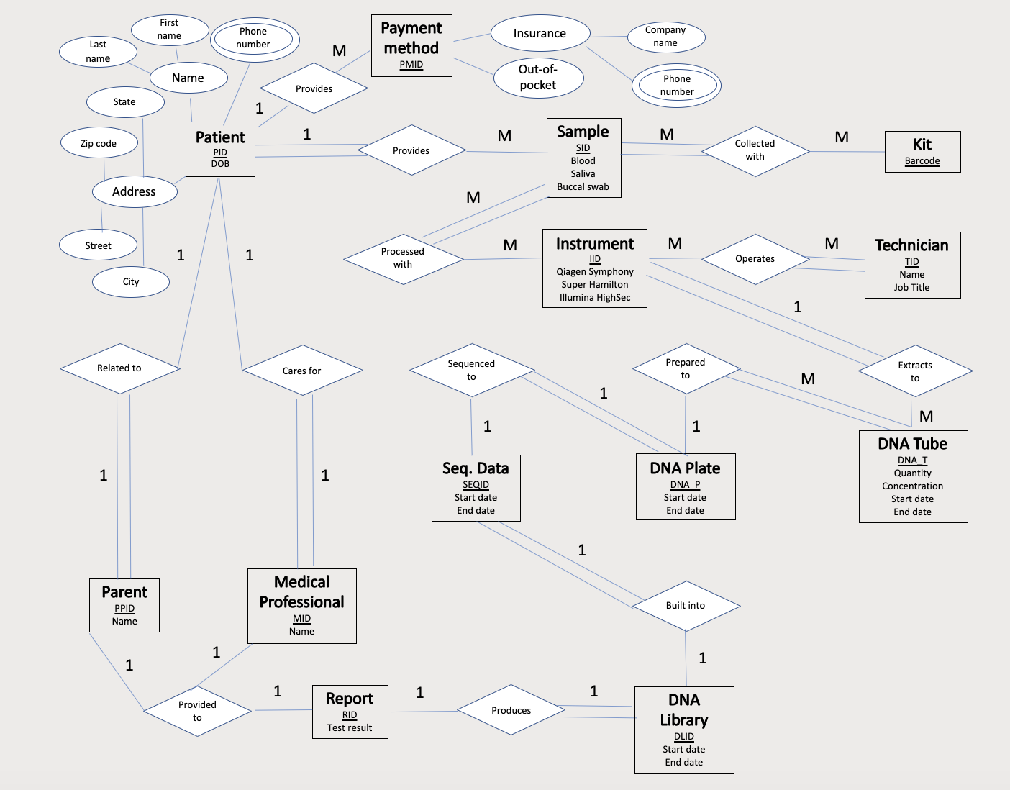
ER Model

Slide 9
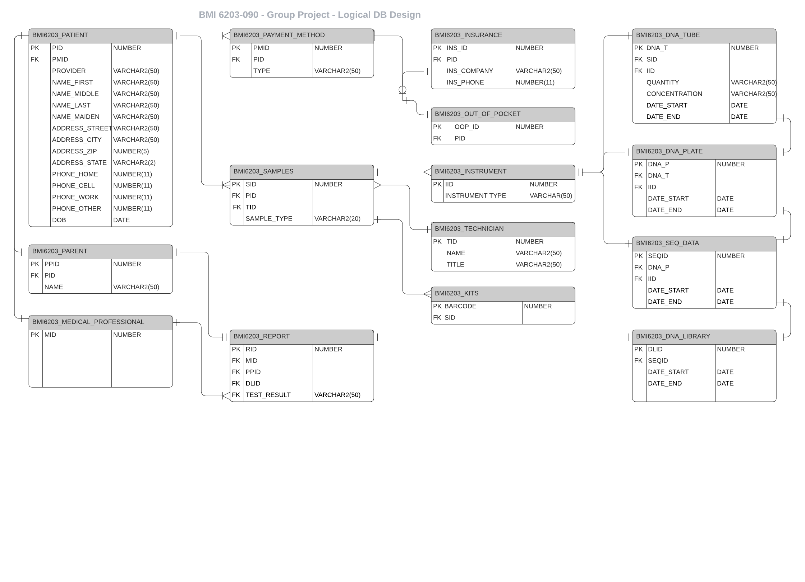
Physical Database

Slide 10
Database Installation and Creation
Oracle 12c Database installed on Centos Linux Server on cloud hosting.
Installation performed via CLI / response file.
Database creation performed via DDL SQL with minor adjustments from SQL Developer UI as work progressed.
Complete DDL exported from SQL Developer

Slide 11
Test Data Generation
Test data was primarily generated utilizing https://generatedata.com.
Date data was generated in Excel via simple formulas.
After creation excel sheets data was imported via SQL Developer into the database. Certain constraints were disabled during the data load, then reenabled after, to allow for successful import.
After all data was successfully imported, an export of all data was create as an sql script.

Slide 12
Queries
How many patients are paying out-of-pocket vs how many have insurance?
How many plates were run on a specified date?
Number of patients from a specified state?
Which instruments were run per individual per specified date?
Which provider(s) received the most reports?

Slide 13
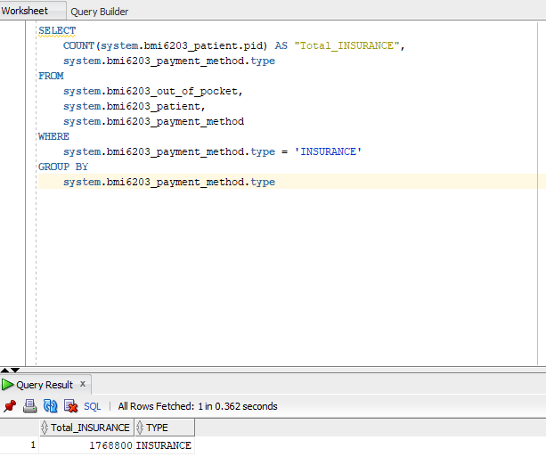
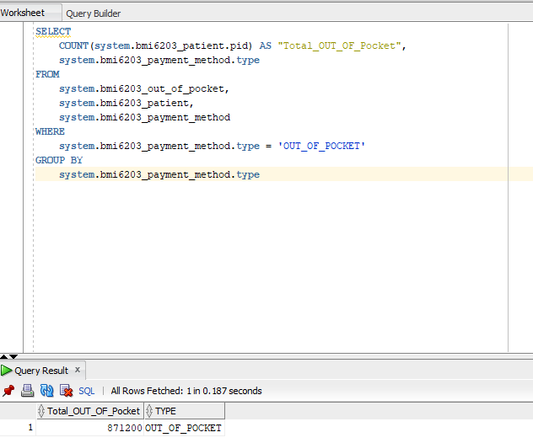
Paying out-of-pocket vs how many have insurance?

Slide 14
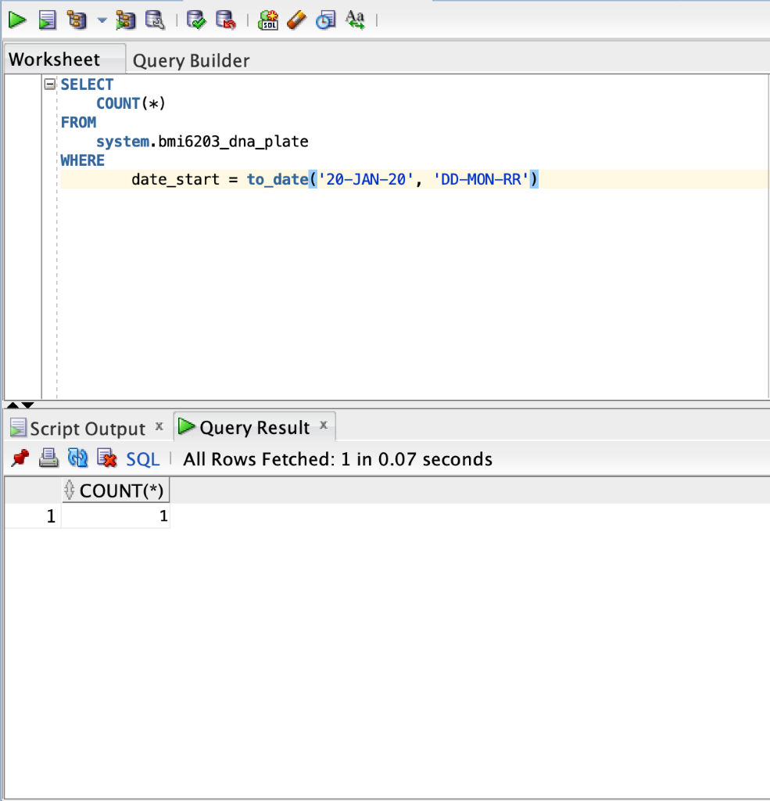
Plates were run on a specified date

Slide 15
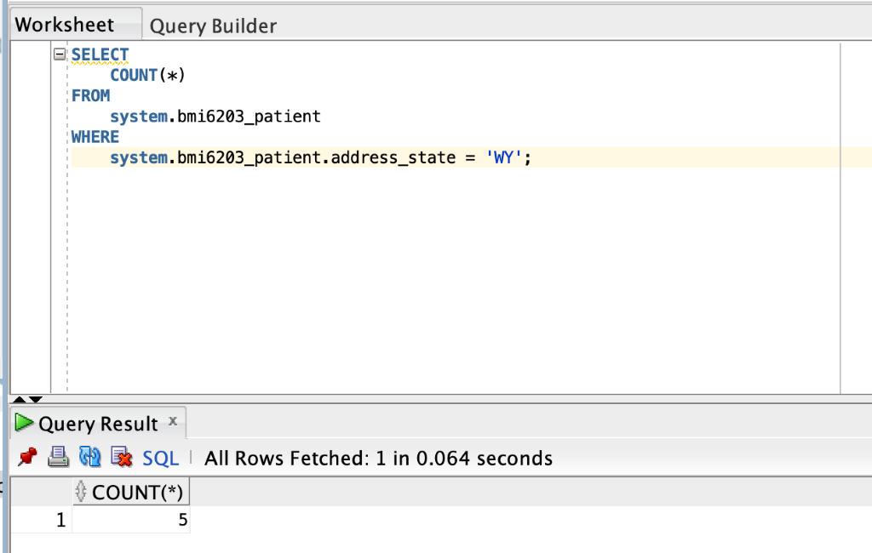
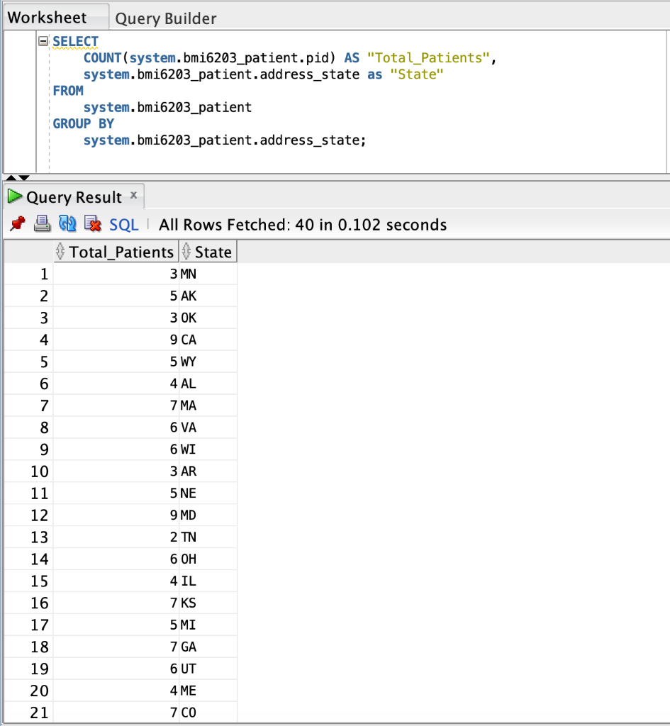
Number of patients from a specified state?

Slide 16
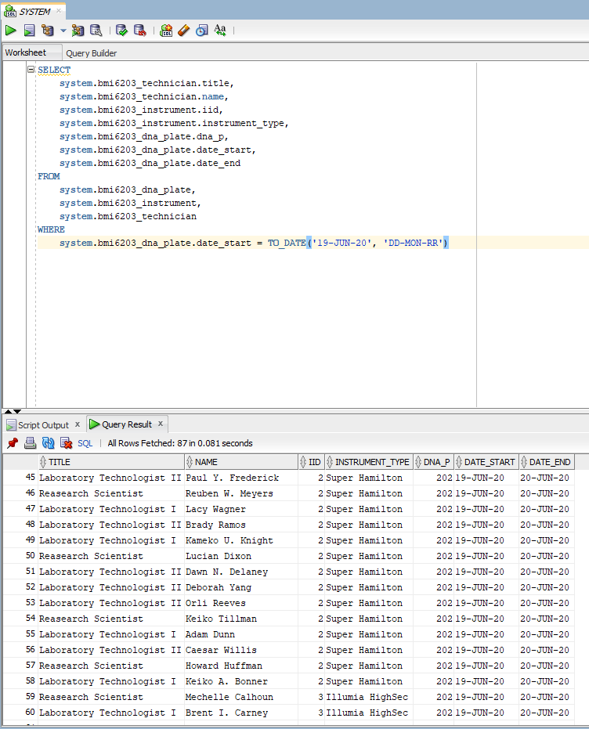
Which instruments were run per individual per specified date?

Slide 17
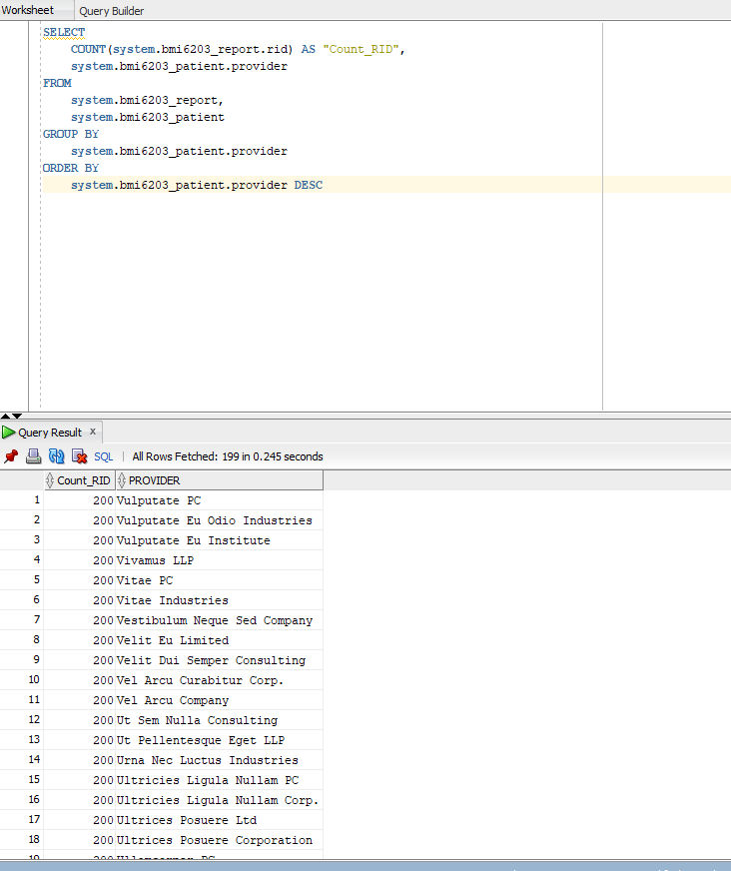
Which provider(s) received the most reports?

Slide 18
Questions?

